Slide 1
Bitcoin Trend Analysis Group Project
Team Boa: Brandie Parker, Charlotte Coolidge, Jong Kim, Junki Ogawa
UPenn Data Science Bootcamp
Notes:
Why/how we chose bitcoin

Slide 2
Core message/Hypothesis
What correlates to Bitcoin price?
Bitcoin price in relation to:
Nvidia stock price
Temperature at Bitcoin mining centers
Gas Price
NYT trending articles
Notes:
Charlotte - opening
We first started with trying to compare Tweets of Elon
Questions we found interesting and what motivated us to answer them
Is bitcoin too volatile? Is it a good investment short/medium/long term?
How accessible is it for entry first time investors ?
Can we provide explanations on Bitcoin highs/lows?

Slide 3
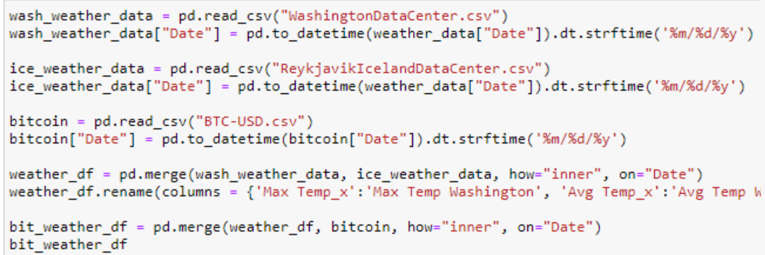
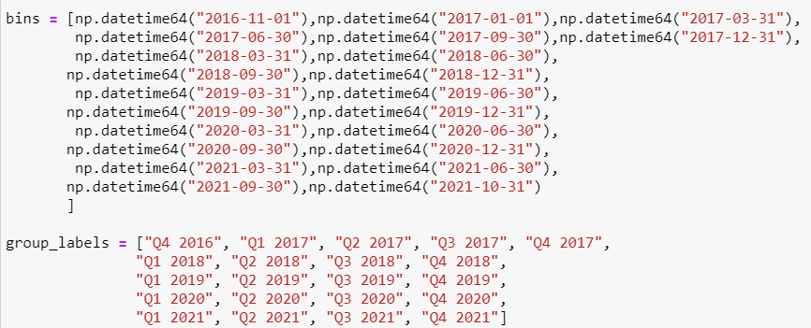
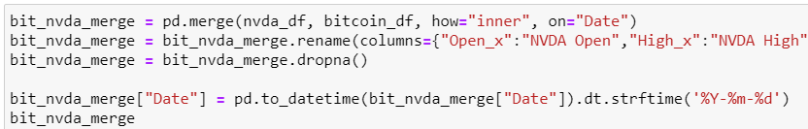
The data exploration and cleanup process
Data Collection
Kaggle
Open Weather API
Yahoo Finance
NYT API
US Energy Information Administration
Data Cleaning and Scrubbing
Match datatypes
Match formats of dates
Dropna
Binning
Notes:
Junki to present NVDA

Slide 4
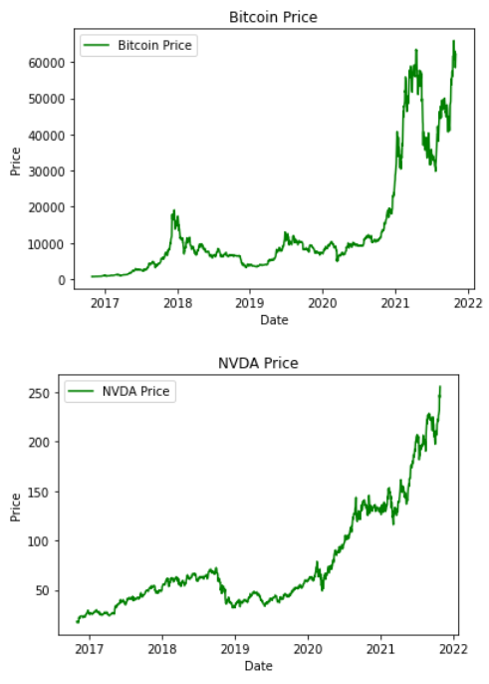
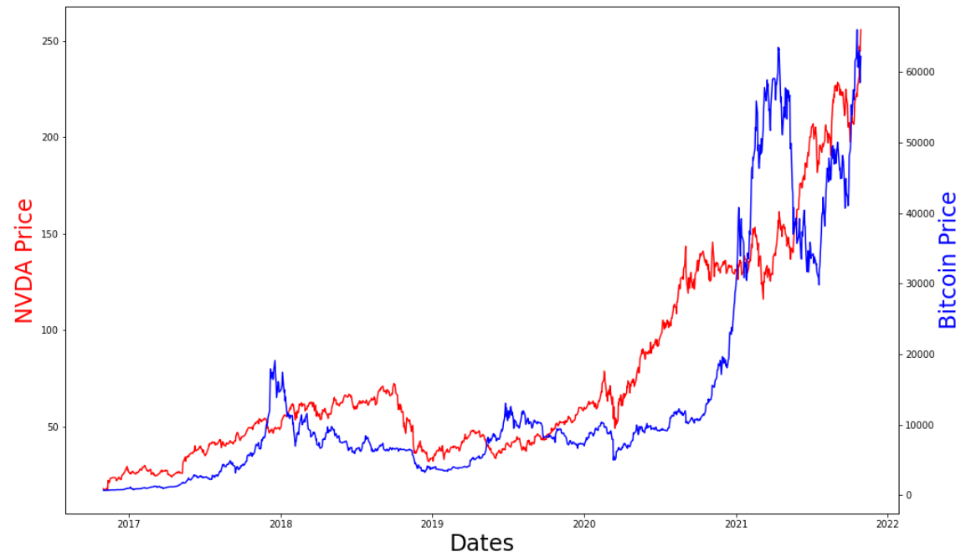
NVIDIA Stock Compared to Bitcoin Price

Slide 5
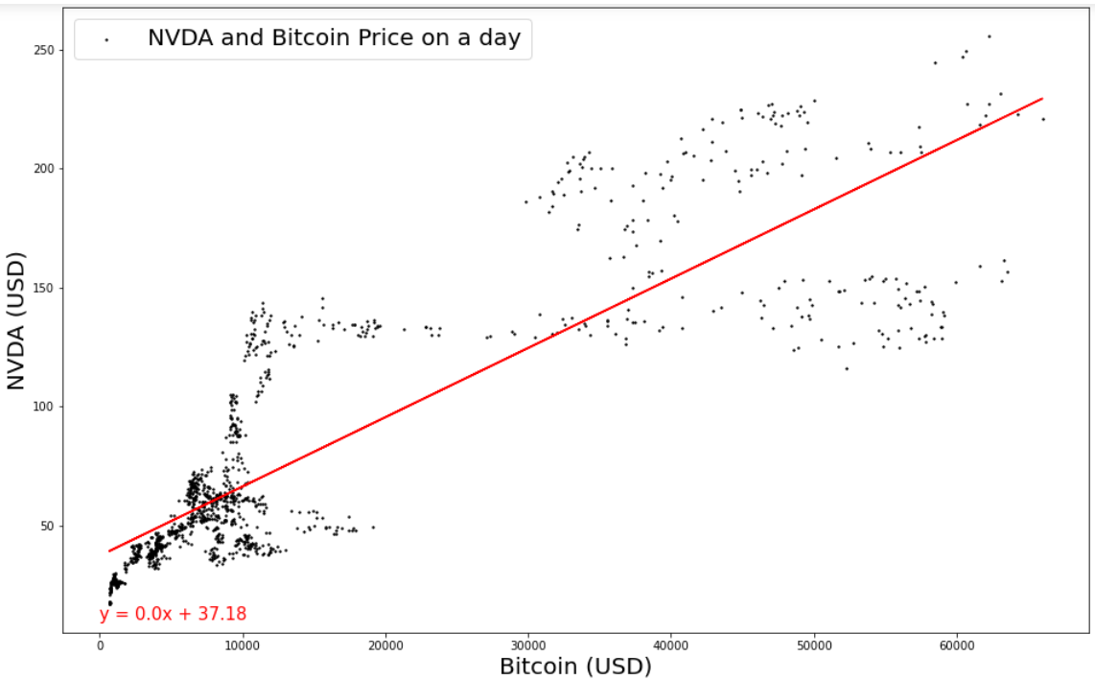
NVIDIA Stock Compared to Bitcoin Price
r value = .85
Strong positive correlation

Slide 6

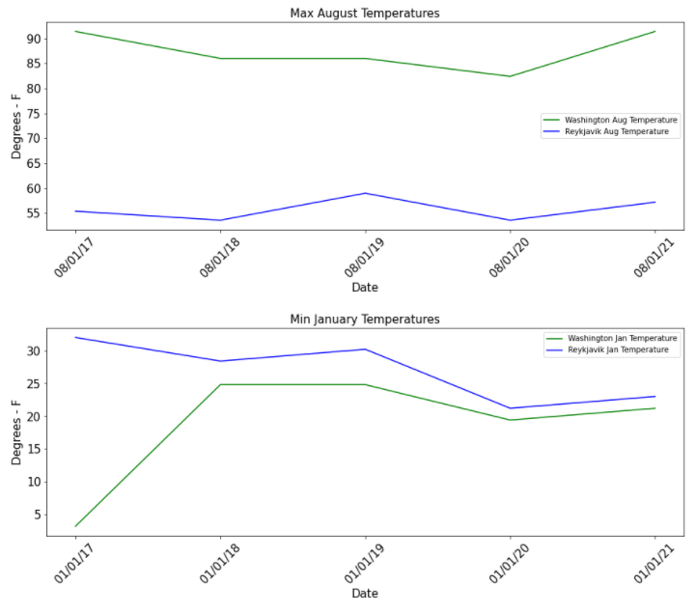
Are there environmental impacts of crypto currency: Temperature
Giga Watt Inc opened in 2017. We also see a significant temperature increase in January in subsequent years in East Wenatchee.
Genesis Mining opened in 2013, though we see the opposite trend in Reykjavik January temperatures.
Notes:
Brandie / Charlotte to present
These countries, and regional areas are being incentivized from an economic perspective to house and run these massive data mining centers (as with the case in Iceland, this business represents 1% of their GDP), but it’s to the detriment of their own microclimates. As, these data centers now account for more electricity use than all of Iceland’s homes combined.
According to local experts cited by The Wall Street Journal, keeping up with demand for electricity requires building more dams and power stations that could alter Iceland’s unique, sensitive environment.

Slide 7
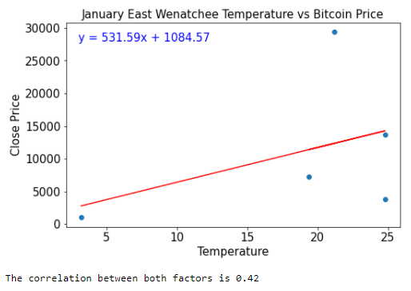
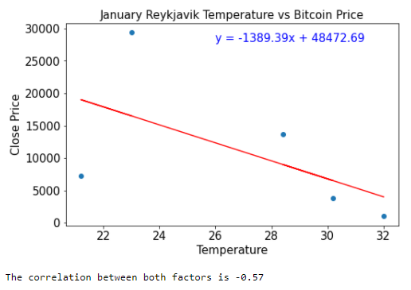
Are there environmental impacts of crypto currency: Temperature
We see similar trends when comparing the January temperatures in both locations against the Bitcoin price.
In East Wenatchee, Washington, there is a slight correlation. The temperatures generally increase as Bitcoin price increases over the years.
We were surprised to find the opposite trend in the January temperatures in Reykjavik, Iceland.
Notes:
Charlotte closing
These countries, and regional areas are being incentivized from an economic perspective to house and run these massive data mining centers (as with the case in Iceland, this business represents 1% of their GDP), but it’s to the detriment of their own microclimates. As, these data centers now account for more electricity use than all of Iceland’s homes combined.
According to local experts cited by The Wall Street Journal, keeping up with demand for electricity requires building more dams and power stations that could alter Iceland’s unique, sensitive environment.

Slide 8
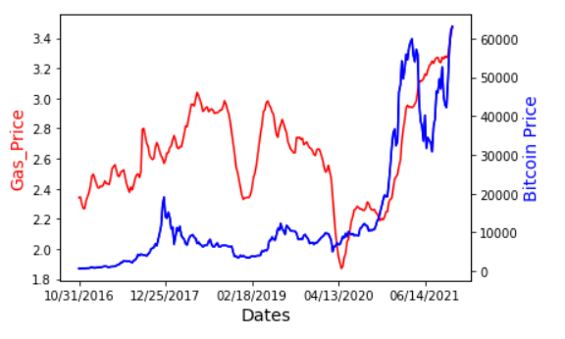
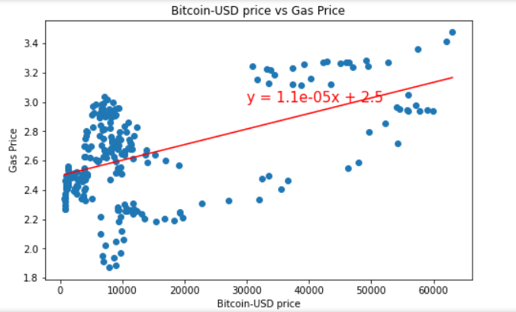
Is there a correlation between gas price and Bitcoin price?
The correlation coefficient between Bitcoin price and Gas Price is 0.51
Notes:
Jong to present
What is the relationship between oil price and gold price?
There's an interesting relationship between gold and oil prices. According to Market Realist, which provides institutional-quality market research, more than 60% of the time, gold and crude oil have a direct relationship. This means that when gold prices rise, crude oil prices also tend to rise, and vice versa.
Resources : Relationship Between Gold and Oil Prices: Why There’s a Big Disconnection in 2020 (yahoo.com)

Slide 9
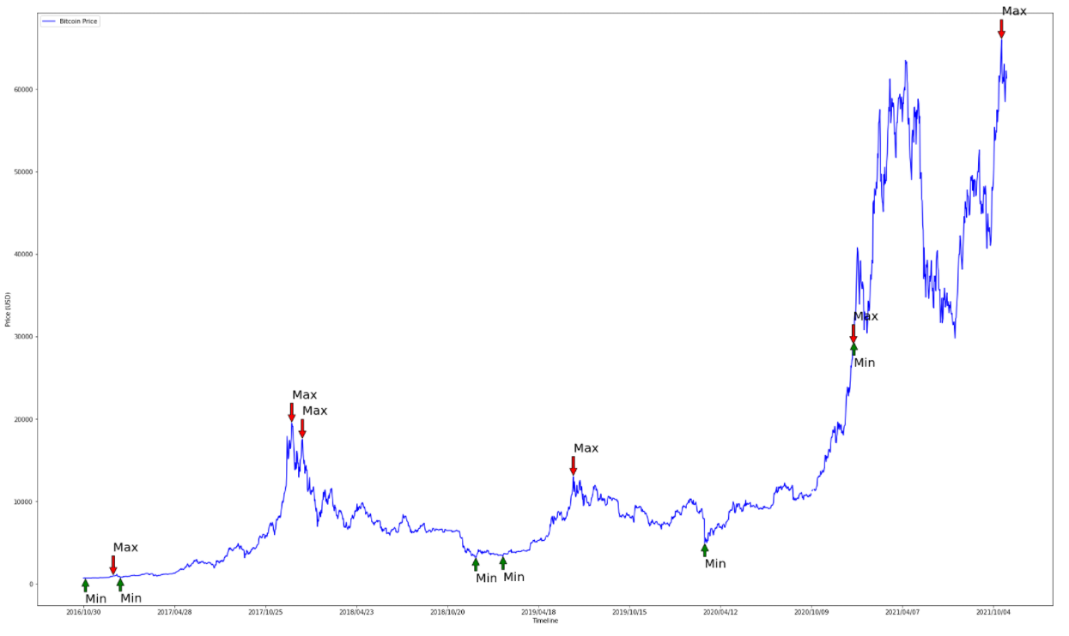
How does news article affects Bitcoin price
Resources : NY Times API
2018-01-12T12:13:59+0000 The government says it is looking at banning virtual currency trades. But it isn’t clear whether, or how quickly, it will follow through.
2021-10-25T19:23:13+0000 What does it mean now that cryptocurrency has joined proper society?
2017-12-19T10:00:21+0000
The Pantera Bitcoin Fund was set up in 2013, when few on Wall Street were interested in cryptocurrencies. It has since ridden the Bitcoin wave to blockbuster returns.
2016-11-09T11:02:35+0000
The uncertainty created by the result has propped up gold and the yen, both safe haven assets.
Searching for articles relavent to “Bitcoin” during max/min price points from 2016 - current year
Notes:
While looking for different factors that that may affect bitcoin price, we also tried to approach using the qualitative analysis to see whether there are evidences that may affect the bitcoin price. While looking at other data sets such as google trend, tweet, and others, we were able to use NYTimes API to automatically pull articles that was published during the different price points that were related to Bitcoins.

Slide 10
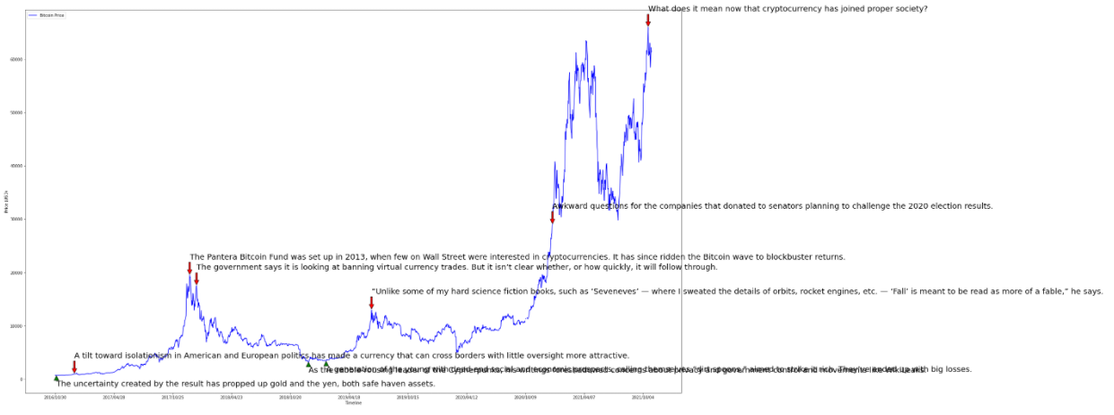
How does news article affects Bitcoin price (Con’t)
Resources : NY Times API
Notes:
Actual screenshot of jupyter notebook outcome

Slide 11
Implications from our findings
Nvidia stock price and Bitcoin price – strong correlation, r=.85
Gas Price – low/moderate correlation, r = 0.51
Temperatures at Crypto Mining Centers – there is a weak correlation to rising Bitcoin prices and temperatures at major Bitcoin mining centers
What we learned
Cleaning data can take longer than expected
Formatting dates to be merged is difficult
Notes:
Charlotte - closure

Slide 12
Resources
Weather Data https://www.worldweatheronline.com/
The Top 5 Largest Mining Operations in the World https://thebitcoinnews.com/the-top-5-largest-mining-operations-in-the-world/
Yahoo Finance : https://finance.yahoo.com/quote/NVDA?p=NVDA&.tsrc=fin-srch
Kaggle https://www.kaggle.com/odins0n/top-50-cryptocurrency-historical-prices https://www.kaggle.com/kaushiksuresh147/bitcoin-tweets
NY TIMES API https://developer.nytimes.com
Data Sournce from US Energy Information Administration https://www.eia.gov/petroleum/gasdiesel/m

